Slide 1
Health Insurance data analysis
Purpose: Analysis of data for recommendation
Name: Moitryee Majumdar

Slide 2
Introduction
This project involved analyzing a health insurance dataset to understand how various factors influence charges for different individuals.
Data visualization techniques were employed to explore patterns across variables such as BMI, smoking status, gender, and number of children.
Hypothesis testing was conducted to examine differences in charges based on these factors. Significant findings include higher charges for smokers and variations across BMI categories and family sizes.
The analysis led to actionable recommendations for the insurance company, such as adjusting premiums based on health risk factors and offering incentives for healthier lifestyles.

Slide 3
Data Description
Sources of the data: Kaggle
Key features:
age : age of the customer.
Sex: Gender of the customer
BMI: Body mass index of the customer shows the healthiness of the individual
children: how many children the individual has.
smoker: Is the person is smoker or not.
region: which region the person belong
chargers: the premium the person is paying
BMI Categories: under weight, normal, overweight, obese
This data helps to understand the relationships between people characteristics and how much it costs to insure them. How much premium would be better for specific person. here the target variable will be charges.

Slide 4
Methodology
In this project there are two techniques that are used one is visualization (Univariate and bivariate) to understand the data more deeply and Hypothesis testing to validate the visualization indications.
This are the most powerful tools to explore , understand, validate insights from data.

Slide 5
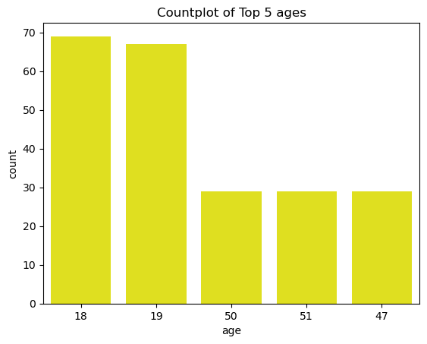
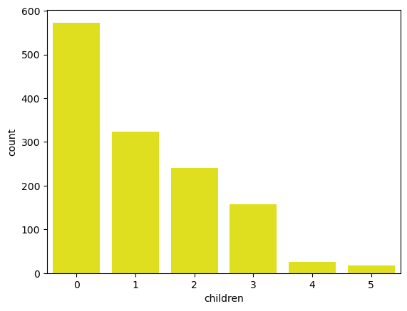
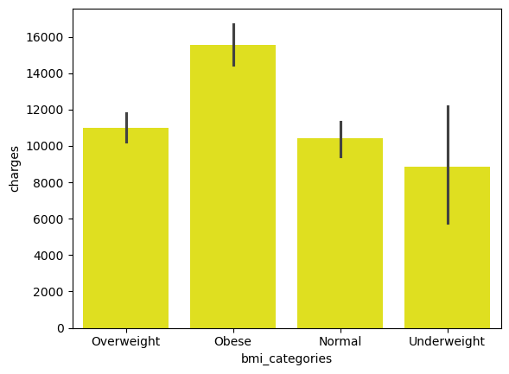
Data visualization
Top 5 ages that are purchasing the insurance
Count of policy holder according to the children the individual has
Count of people according to the BMI categories

Slide 6
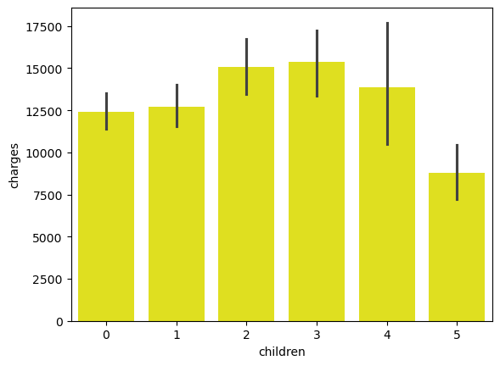
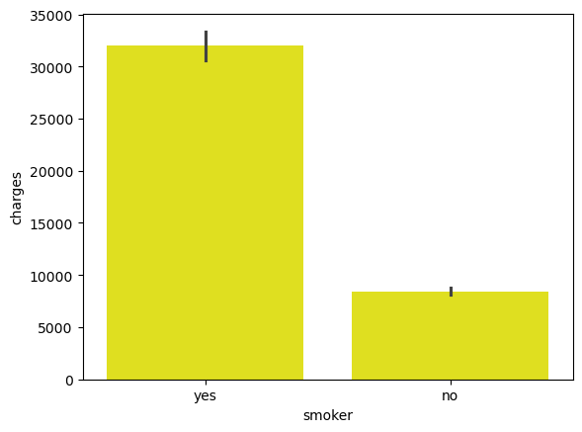
Visualization continued
Charges distribution according to the number of children
Charges Distribution according to the smoker or not

Slide 7
Hypothesis Testing
Test the assumption male are giving more premiums then female policy holders.
there is significant difference between median of BMI categories.
there is significant difference between the rank sum of the smoker and non smoker people.
there is significant difference between the number of children and there charges.

Slide 8
Recommendation
Since there is no significant difference in charges between male and female policyholders, the company can maintain gender-neutral pricing strategies. This approach supports fairness and equality and can help in avoiding potential legal and ethical issues related to gender discrimination.
The company should consider adjusting premiums based on BMI categories, especially if the analysis shows that certain BMI categories (e.g., Obese) incur higher medical costs. This could incentivize healthier lifestyles among policyholders. However, the company should also be cautious of potential ethical concerns and ensure that any adjustments are made transparently and fairly.
Given the significant difference in average charges between smokers and non-smokers, the company should consider implementing higher premiums for smokers. This aligns with the increased health risks associated with smoking.
Since charges differ significantly based on the number of children, the company may want to explore offering family or child-focused insurance plans with different premium structures. For families with more children, the company could consider offering multi-child discounts or bundled family plans.

Slide 9
Thank you

